Slide 1
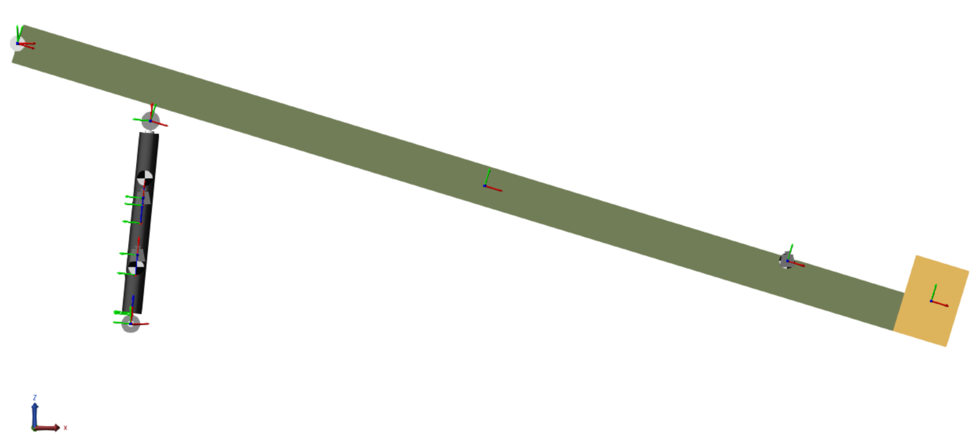



$$A$$
$$C$$
$$B$$

